Slide 1
Subject: DATA MINING
Lecturers: PHAUK Sokkhey and CHAN Sophal
Class: M1 Computer Science
Presenter: HUON Sophy

Slide 2
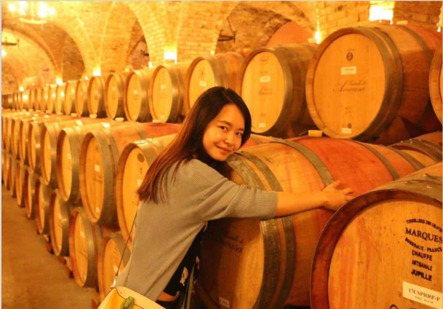
Red
Wine Quality
Prediction

Slide 3
Content
Introduction
Objective
Dataset
Methodology
Result
Conclusion

Slide 4
I. Introduction
Wine is a beverage made from rice, grape, and other fruit juices with a lower amount of alcohol.
Quality of wine is graded based on the taste of that wine.
The process is time taking, costly, and not efficient.
The processing of the analysis of the quality, we have used a few machine learning algorithms.
The features of the wine: fixed acidity, volatile acidity, citric acid, residual sugar, chlorides, free sulphur dioxide, total sulphur dioxide, density, pH, sulphates, alcohol and quality.

Slide 5
II. Objective
Use machine learning algorithms to build a model to predict the quality of wine by classifying the quality of wine into Bad, Good.
Prepare and select data for input into the models

Slide 6
III. Dataset
We do some data preprocessing
Red wine: https://www.kaggle.com/datasets/piyushgoyal443/red-wine-dataset
Handling missing values: fill missing values by using statistical imputation with mean() and mode().
Handling feature Selection: used Correlation Statistical for feature selection.
Handling outliers: apply outlier detection and treatment by using Interquartile Range (IQR) Score.
Feature Scaling: different values in the dataset has a variety of ranges.

Slide 7
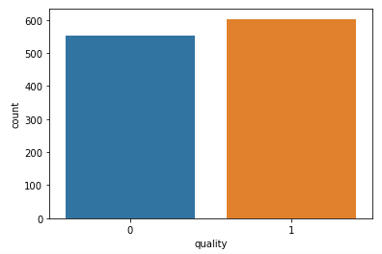
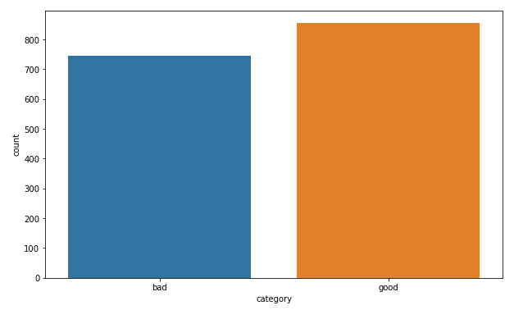
III. Dataset (Cont)
Regrouping the type of quality: we categorize variable quality into two categories: 0-5: Bad, and 6-10: Good.

Slide 8
IV. Methodology
After cleaning, the dataset contains a total of 1599 rows
Training set contains 70% of the total rows
Testing set contains 30% of the total rows
Evaluation Metric: accuracy score and classification report

Slide 9
IV. Methodology (Cont.)
We build four models to classify the quality of wine
RandomForestClassifier: Ranmodel
Logistic Regression: LR
Support Vector Machine: Svm_model
K-Nearest Neighbor(KNN): Knnmodel

Slide 10
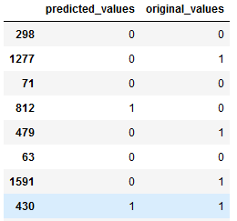
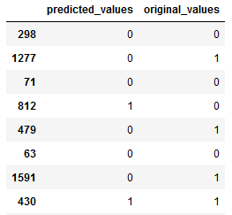
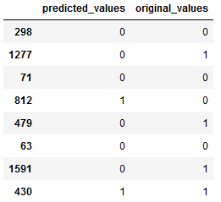
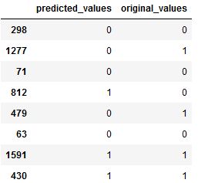
V. Result
Accuracy of 4 models:
Ranmodel | LR | Svm_model | Knnmodel
73.134 | 70.746 | 71.04 | 75.223

Slide 11
V. Result (Cont.)
Accuracy, Precision, Recall, and F1-Score of 4 models:
 | Model | Accuracy | Precision | Recall | F1 Score | ROC
0 | Random Forest Classifier | 73.134328 | 81.333333 | 66.304348 | 73.053892 | 73.880651
1 | Logistic Regression | 70.746269 | 81.617647 | 60.326087 | 69.375000 | 71.884898
2 | Suport Vector Machine | 71.044776 | 81.294964 | 61.413043 | 69.969040 | 72.097250
3 | K-Nearest Neighbor(KNN) | 75.223881 | 81.366460 | 71.195652 | 75.942029 | 75.664051

Slide 12
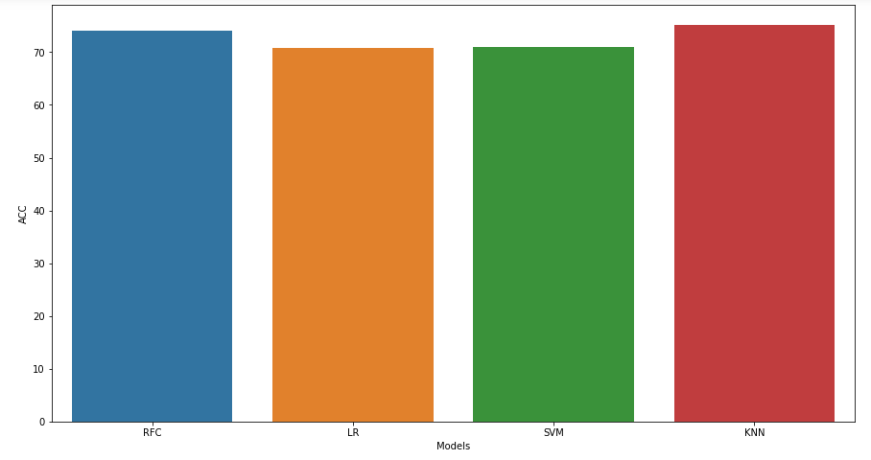
V. Result (Cont.)
The visualize of 4 models:

Slide 13
VI. Conclusion
We analysed a red wine dataset with almost 1599 observations with 12 variables.
categorize variable quality into three categories: 0-5: Bad, and 6-10: Good.
Cleaning data by filling a missed values
Using feature selection to filter out not important fields, and transform data
Visualization of data in the graph
Understanding the problem and applying machine algorithm to solve that problem

Slide 14


